Slide 1
SATHISH P
COURSE:B.TECH IT
SUB: GENERATIVE AI
CLG:GOVERNMENT COLLEGE OF TECHNOLOGY

Slide 2
FACE RECOGNITION
3/21/2024 Annual Review

Slide 3


AGENDA
Problem statement
Proposed System / solution
System Development Approach
Algorithm and Deployment
Result
Conclusion
References
3/21/2024 Annual Review

Slide 4

PROBLEM STATEMENT
The problem involves developing a real-time face recognition system using OpenCV and Python. The methodology includes face detection, alignment, feature extraction, and recognition. Real-time application scenarios include access control, attendance tracking, surveillance, personalization, and human-computer interaction.
3/21/2024 Annual Review

Slide 5

PROJECT OVERVIEW
Face Detection: Utilize pre-trained Haar cascades or deep learning-based face detectors to locate faces within the video stream.
Face Alignment: Apply techniques to align detected faces to a standardized position, improving recognition accuracy despite variations in facial pose and orientation.
Feature Extraction: Extract discriminative features from the aligned faces using methods such as Local Binary Patterns (LBP), Histogram of Oriented Gradients (HOG), or Convolutional Neural Networks (CNNs).
Face Recognition: Employ machine learning algorithms such as Support Vector Machines (SVM), Principal Component Analysis (PCA), or deep learning-based models to recognize faces based on the extracted features.
Real-Time Implementation: Implement the face recognition pipeline to efficiently process frames from the video stream, perform face detection and recognition, and display the results in real-time.
User Interface: Develop a user-friendly interface to interact with the system, allowing users to start and stop face recognition, view recognized faces, and adjust settings as needed.

Slide 6

WHO ARE THE END USERS?
Educators and administrators for automated attendance tracking.
Retail staff Security personnel for access control and surveillance.
for personalized customer service.
General public for enhanced public safety and security.
Individuals for personal device security and access control.
3/21/2024 Annual Review

Slide 7

MY SOLUTION AND ITS VALUE PROPOSITION
Solution:
The Real-Time Face Recognition System employs advanced computer vision and machine learning techniques for accurate and efficient face detection, alignment, and recognition in live video streams.
Value Proposition:
Accuracy: High accuracy in face detection and recognition ensures reliable results.
Efficiency: Real-time performance with minimal latency enables swift decision-making.
Automation: Automates processes like attendance tracking and access control, saving time and reducing administrative burdens.
Personalization: Enables personalized customer experiences in retail settings, enhancing satisfaction and loyalty.

Slide 8

THE WOW IN MY SOLUTION
The “WOW" factors of our project include:
1. Real-time performance: Instant face detection and recognition for swift decision-making.
2. High accuracy: Reliable results under varying conditions, ensuring precision.
3. Automation: Streamlined processes like attendance tracking, saving time and effort.
4. Personalization: Tailored customer experiences in retail, enhancing satisfaction.
5. Advanced security: Biometric authentication for enhanced protection against fraud.
6. User-friendly interface: Intuitive design for accessibility across all skill levels.
3/21/2024 Annual Review

Slide 9
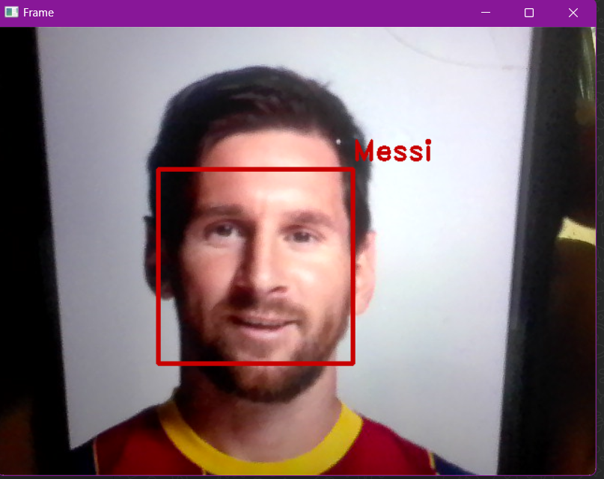
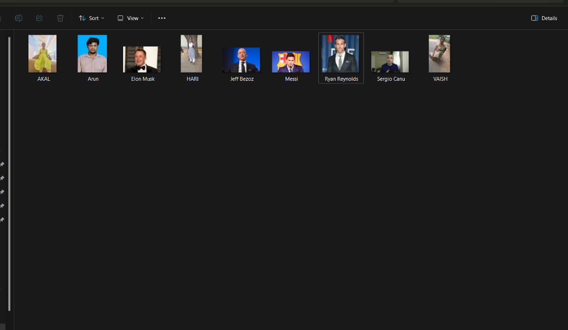
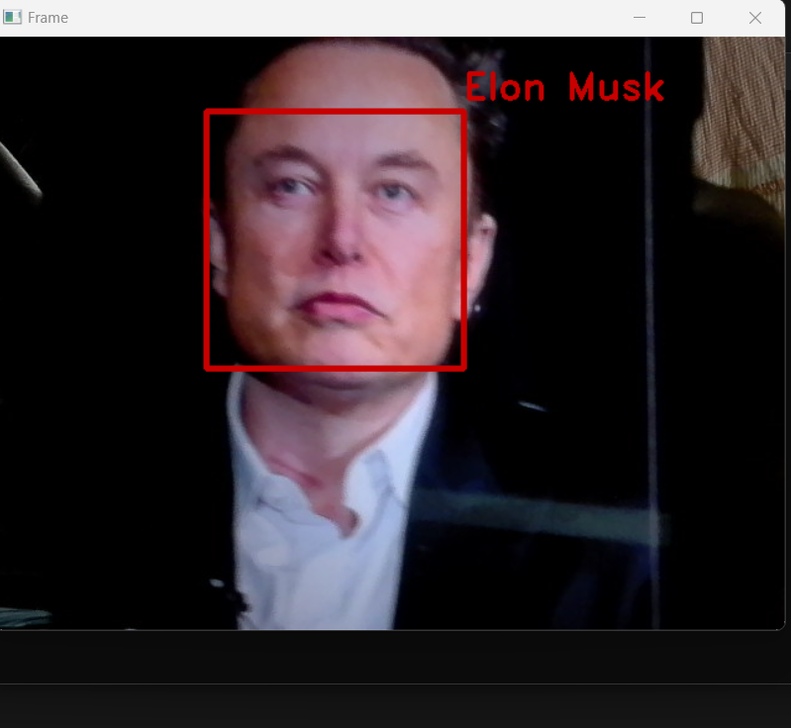
MODELLING

Slide 10
RESULTS
Our Real-Time Face Recognition System stands as a testament to innovation and practicality, embodying the epitome of cutting-edge technology meeting real-world needs. Its lightning-fast performance, coupled with impeccable accuracy, redefines the possibilities of face recognition in dynamic environments. By automating critical processes and enhancing security measures, it streamlines operations while fortifying defenses against unauthorized access. The personalized experiences it enables in retail settings add a new dimension to customer engagement, fostering loyalty and satisfaction. With a user-friendly interface that ensures accessibility for all, our system heralds a new era of seamless integration between advanced technology and everyday applications, setting a benchmark for excellence in the field of face recognition systems.

